Slide 1
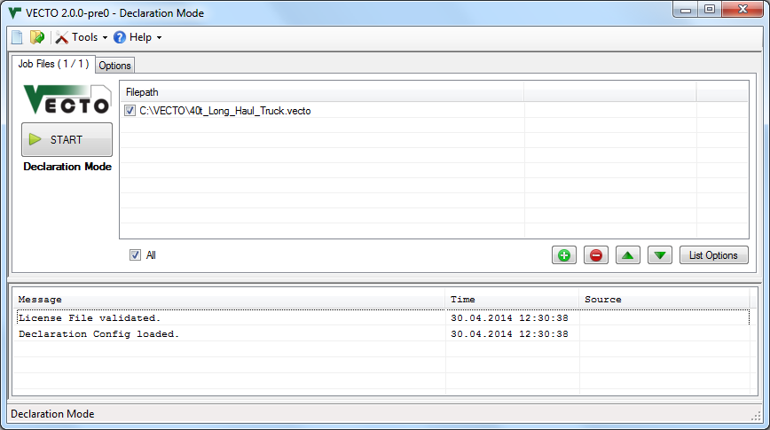
Job List
Message List
Statusbar

Slide 2
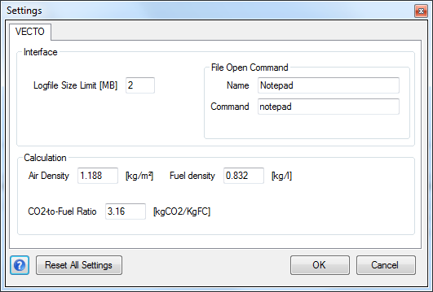

Slide 3
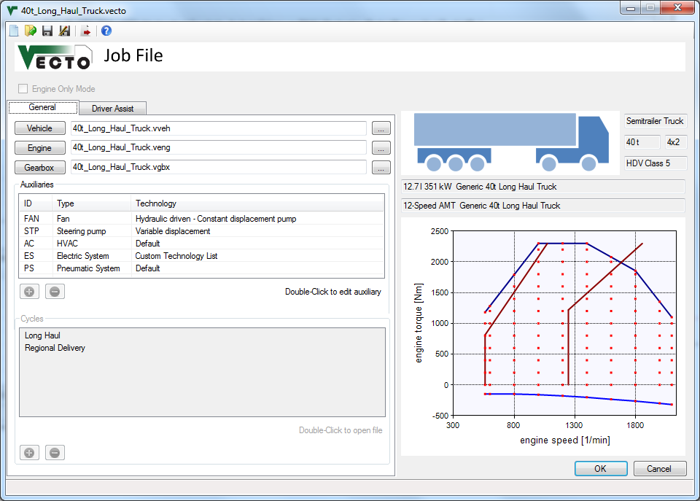
Chart Area

Slide 4
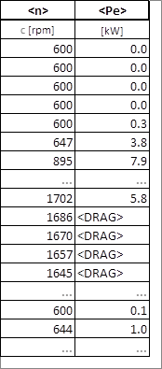
Engine motoring operation. Can also be used with <Me>

Slide 5
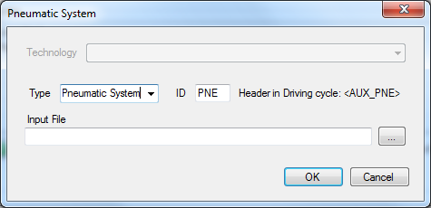
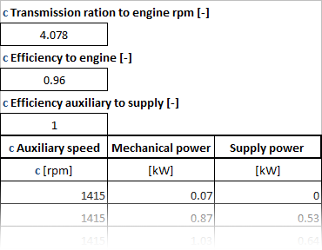

Slide 6
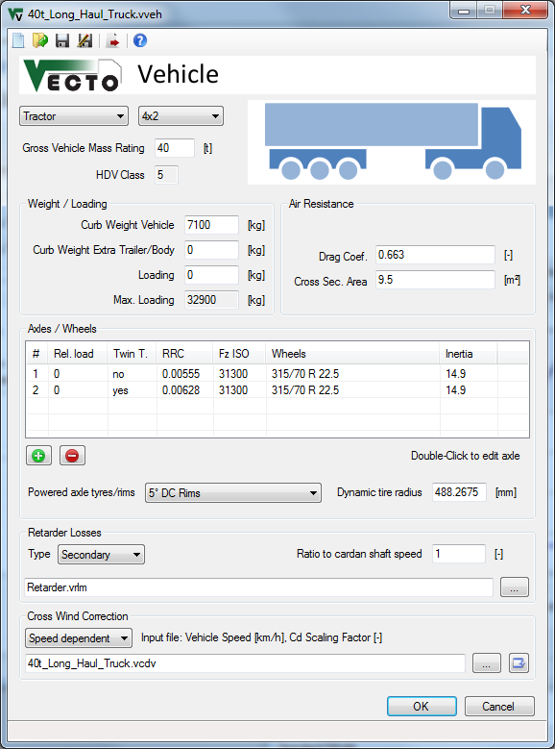
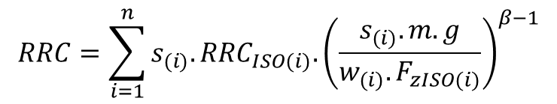
$$RRC=\sum_{i=1}^{n}{{s_{(i)}.RRC}_{ISO(i)}.{\left(\frac{s_{(i)}.m.g}{{w_{(i)}.F}_{zISO(i)}}\right)}^{β−1}}$$

Slide 7
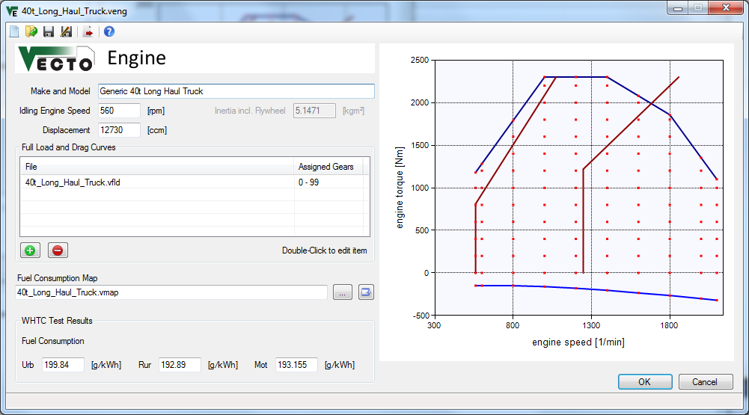
Chart Area

Slide 8
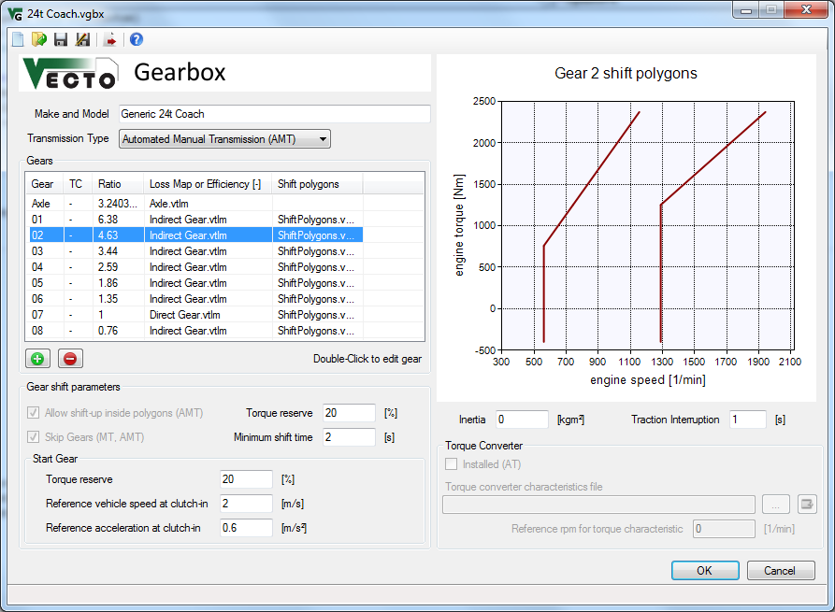
Chart Area
$$Output Torque=\left(Input Torque−Torque Loss\right)×GearRatio$$

Slide 9
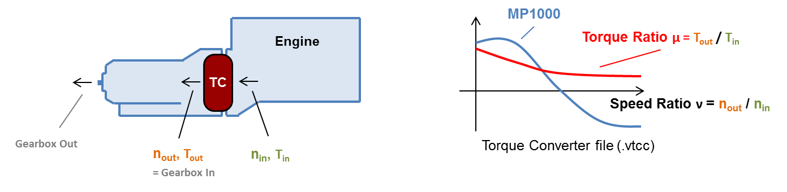
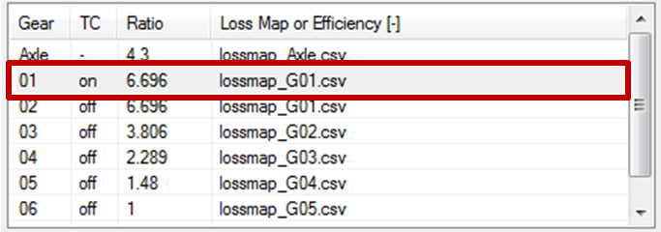
Original in Update Notes.pptx

Slide 10
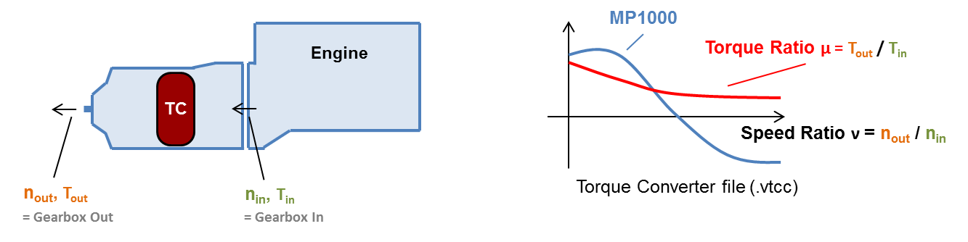
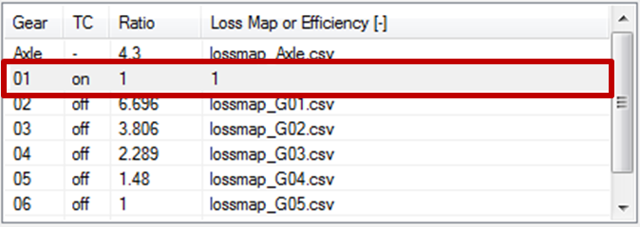
Original in Update Notes.pptx

Slide 11
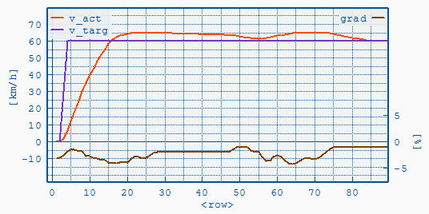
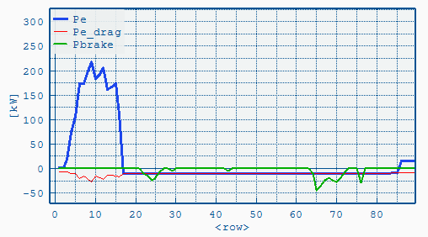
Coasting with Brakes applied if Overspeed is reached

Slide 12
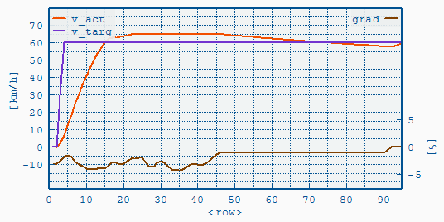
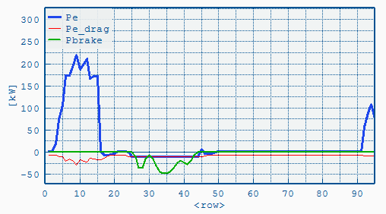
Overspeed reached:
Coasting & Braking
Engine idling

Slide 13
T = (vset₁-vset₂) / a_{lookahead} e.g. a_{lookahead} = -0.5m/s²
V
Vset₁
Deceleration according to a_{brake}=f(v)-curve e.g. = -1m/s²
coasting phase
resulting vehicle speed course
Vset₂
time

Slide 14
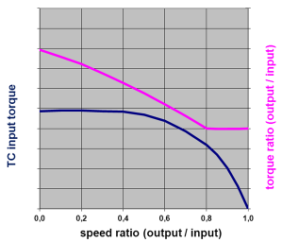
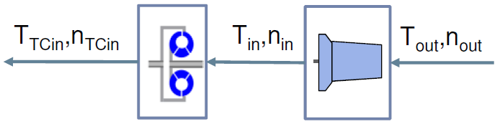
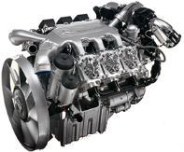
Torque converter characteristic (.vtcc file)
Quasi stationary backwards calculation
Transmission losses added
Longitudinal dynamics
Iteration
Engine
Torque converter
Transmission

Slide 15
.vaux file
.vdri file
TransRatio
EffToEng
EffToSply
AuxMap(n,Pe)
Psupply

Slide 16
1) n_{Aux} = n_{Eng} * TransRatio
with: n_{Eng} = engine speed
2) P_{AuxOut} = Psupply / EffToSply
3) P_{AuxIn} = AuxMap(n_{Aux}, P_{AuxOut})
4) P_{AuxDemand} = P_{AuxIn} / EffToEng
P_{AuxDemand} is directly added to the engine's power demand

Slide 17
